Slide 1

AI-Based Real-Time Defect Detection in 3D Printing
Real-time AI-powered monitoring and defect FDM 3D printing using edge computing and Raspberry Pi.

Slide 2

The Challenge of 3D Printing Failures
Additive manufacturing, especially FDM, offers cost-effective production but is highly prone to failures like spaghetti defects, stringing, and poor bed adhesion. These issues lead to material waste, increased production time, and reduced quality.
Common Defects
Spaghetti defects, stringing, poor bed adhesion, under-extrusion, print interruptions.
Impact
Material waste, increased production time, reduced print quality.

Slide 3







Evolution of AI-Based Defect Detection
Early Vision-Based Systems
Initial research by Yean et al. (2024) used image processing and ML on Raspberry Pi for basic defect detection (spaghetti, stringing), but struggled with dynamic conditions and lighting.
Deep Learning Advancements
Pawde et al. (2024) introduced deep learning (e.g., YOLO) for enhanced real-time defect identification, significantly improving accuracy and speed over traditional methods.
Low-Contrast Challenges
Leenheer (2025) highlighted the limitations of vision-based systems in scenarios with low visual contrast or subtle defect features, necessitating new approaches.
Future Hardware & Paradigms
Future directions include hardware solutions like LiDAR for 3D data capture and exploring alternative ML paradigms beyond supervised learning to overcome current sensor limitations.
System-Level Reliability
Ackerman et al. (2022) emphasized the critical need for robust, explainable, and integrated AI systems for industrial deployment, focusing on overall process reliability.
Closed-Loop Adaptive Systems
Sani et al. (2024) proposed a shift towards closed-loop AI systems that not only detect but also adapt and correct manufacturing processes in real-time, preventing future defects.

Slide 4

Limitations of Current Solutions
Despite academic progress, commercial solutions face significant limitations in practical settings.
Cloud-Based (Obico)
Hardware-Integrated (Bambu Lab)
High accuracy, but requires internet.
Seamless experience, but proprietary.
Latency and privacy concerns.
High cost, limited accessibility.

Slide 5
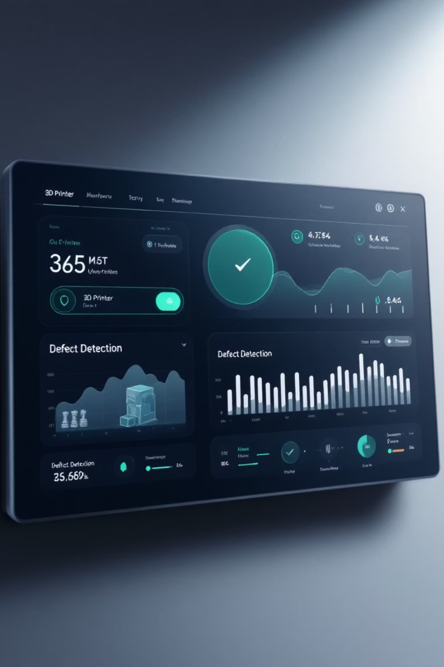




The Need for a New Solution
A clear gap exists for a lightweight, privacy-preserving, and cost-effective AI monitoring system.
Edge Hardware
Operates entirely on local devices.
Privacy-Preserving
No reliance on continuous internet.
Cost-Effective
Accessible for existing FDM printers.
Intuitive Dashboard
Real-time quality monitoring.

Slide 6




Primary Use Cases
Our system supports the complete lifecycle of 3D print monitoring, from initiating a print to reviewing historical performance and proactively addressing defects.
Start Print Monitoring
Detect Failure and Alert User
Review Past Session Results
User opens dashboard, uploads model, clicks "Start Session". System verifies camera and inference readiness, then begins capturing, detecting, and displaying a live feed.
System captures a frame, AI detects a defect above threshold, creates an alert event, saves a snapshot, displays an alert banner on the dashboard, and can send external notifications.
User opens the History section, selects a past session, and the system displays a detailed timeline, associated alerts, captured snapshots, and overall summary metrics.

Slide 7









Functional Requirements
Non-Functional Requirements
Target Defect Detection
Latency
Identify specific defect types including weight detachment, layer shifts, and nozzle clogging.
End-to-end processing (≤ 500 ms).
Throughput
Real-Time Alerts
Real-time processing (≥ 10 FPS).
Generate immediate notifications containing defect class, timestamp, and confidence score.
Accuracy
Interactive Dashboard
Model performance (≥ 85%).
Provide a web interface for live monitoring with bounding box overlays.
Reliability
System uptime (99%).
Safety Hooks (Optional)
Capability to trigger a relay pin via GPIO 23 when high-confidence defects occur.
Privacy
Local only.

Slide 8
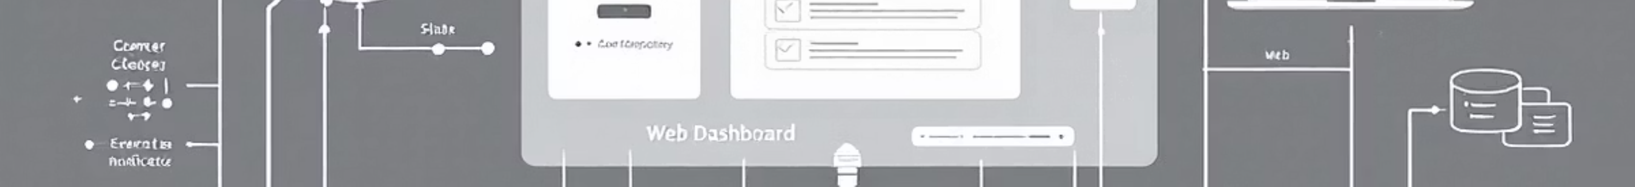

High-Level System Architecture
Our system is designed for efficiency and real-time responsiveness, leveraging a streamlined data pipeline from raw video capture to user-facing insights, all processed at the edge.
Camera Module
A Raspberry Pi camera captures live video footage of the 3D printing process.
Capture Service
Acquires and preprocesses video frames, optimizing them for AI inference.
Inference Service
On-device AI model performs real-time defect detection, generating events for anomalies.
Backend API
Handles communication, distributing real-time defect alerts and visual snapshots.
Web Dashboard
User interface providing live video, defect notifications, and print history.

Slide 9






Technology Stack & Trade-offs
Our solution is built on a carefully selected technology stack, balancing performance, cost-effectiveness, and real-time capabilities for edge deployment.
Hardware
Raspberry Pi 4/5: Chosen for its low cost, sufficient processing power for lightweight AI inference, and extensive community support.
Backend
Python + FastAPI: Python's rich ML ecosystem and rapid prototyping capabilities are leveraged. FastAPI provides high performance, asynchronous operations, and built-in WebSocket support.
AI/ML
YOLO-based Object Detection: Offers proven real-time performance and a good balance between accuracy and inference speed. TensorFlow Lite/ONNX Runtime: Optimized for efficient execution on edge devices like the Raspberry Pi.
Frontend
React: A lightweight, flexible library for building dynamic user interfaces, providing strong support for real-time data visualization.
Communication & Storage
In-memory queue: For high-speed data transfer between Capture and Inference services. WebSocket: Enables real-time event pushing from Backend to Dashboard. REST: Standard API for Dashboard-to-Backend communication. SQLite + File System: For local, lightweight data persistence.

Slide 10
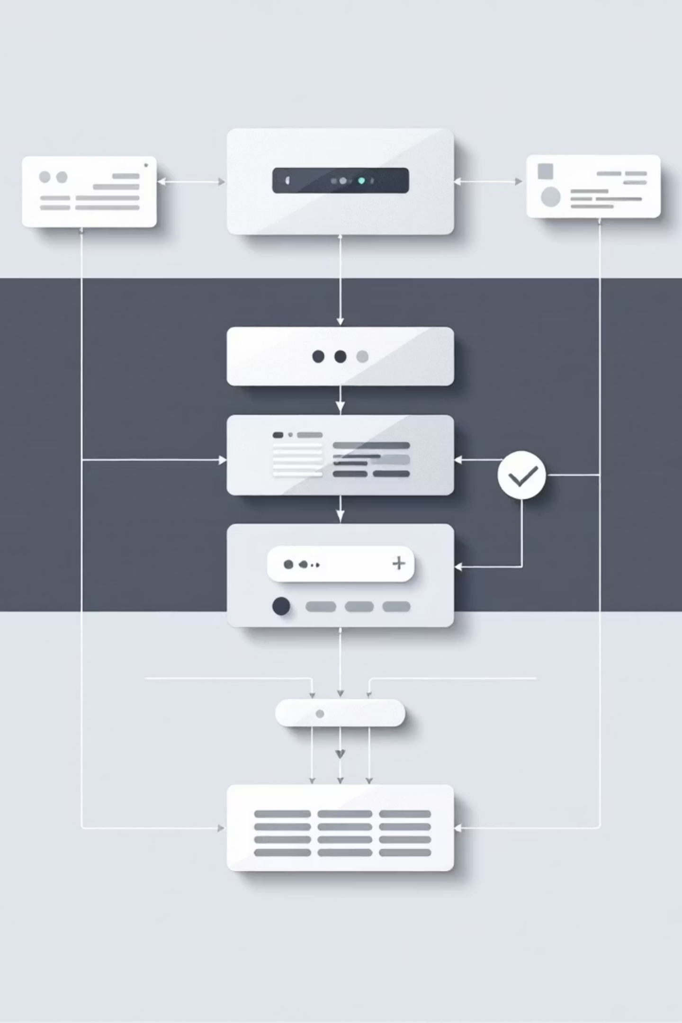
High-Level Components
Camera Capture
AI Analysis Engine
Frame acquisition & timing
YOLO-based object detection
Image preprocessing
Confidence filtering
Storage Service
Web Dashboard
Frame log for ML management
Live video feed with overlays
System logging
Historical defect logs
System logging & config
Alert System
Real-time notifications
Severity classification
External integration hooks

